Slide 1
Advanced Dimensional Modeling

Slide 2
Slowly Changing Dimensions
Hybrid Type: Combination 1, 2 & 3 changes
New attribute for predictable series (such as yearly changes)
Type 2 changes with prior or original attributes included
Expanded dimension table for durable key inclusion in fact
Added complexity to users

Slide 3
Hybrid Slowly Changing Dimension Techniques
Two approaches that combine the basic SCD techniques:
Predictable changes with multiple version overlays
Unpredictable changes with single- version overlay
These approaches provide more flexibility at the cost of greater complexity

Slide 4
Predictable Changes with Multiple Version Overlays
Used in cases of sales organization realignments
Example: Over a 5-year period the sales organization is reorganized five times.
At first sight, candidate for Type 2 approach (add dimension row), but more complex business requirements. E.g.,
Report each year’s sales using the district map for that year
Report each year’s sales using the district map from an arbitrary different year
Report an arbitrary span of years’ sales using a single district map from a chosen year.
Type 3 is also inappropriate because >2 district maps
Because changes are predictable, an extension of Type 3 is possible → Multiple District columns:
Current District; District 2001; District 2002; …

Slide 5
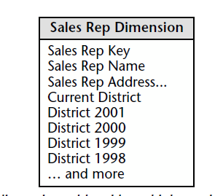

Slide 6
Unpredictable Changes with Single-Version Overlay
Preserve historical accuracy surrounding unpredictable attribute changes while supporting the ability to report historical data according to the current values
Issue a new dimension row (type 2) to capture the change and add a new dimension column to track the historical value (type 3). Also, overwrite “Current Department” value (Type 1).
See example on page 104.

Slide 7
Rapidly Changing Dimensions
From the previous slides: What is slow?
What if the changes are fast?
Must a different design technique be used?
• Small dimensions:
– the same technologies as for slowly changing dimensions may be applied
• Large dimensions:
– the choice of indexing techniques and data design approaches are important
– find suppress duplicate entries in the dimension
– do not create additional records to handle the slowly changing dimension problem

Slide 8
Rapidly changing very large dimensions
• Break off some of the attributes into their own separate dimension(s), a demographic dimension(s).
– force the attributes selected to the demographic dimension to have relatively small number of discrete values
– build up the demographic dimension with all possible discrete attributes combinations
– construct a surrogate demographic key for this dimension
NB! The demographic attributes are the one of the
heavily used attributes. Their values are often
compared in order to identify interesting subsets.

Slide 9
More Rapidly Changing Dimensions
Break off the rapidly changing attributes into one or more separate dimensions
Two foreign keys in fact table:
Primary dimension table
Rapidly changing attribute(s)

Slide 10
Rapidly Changing Monster Dimensions
Multi-million customer dimension present unique challenges that warrant special treatment:
Browsing or constraining takes too long
Type-II change not feasible
Business users want to track the myriad of customer attribute changes, e.g., insurance companies want accurate information of customers at the time of approval of a policy or when a claim is made

Slide 11
Mini-Dimensions
Single technique to handle browsing-performance & change tracking problems
Separate out frequently analyzed or frequently changing attributes into a separate dimension, called mini-dimension

Slide 12
Mini-Dimensions
Demographic Key | AGE | GENDER | INCOME LEVEL
1 | 20-24 | M | < 20000
2 | 20-24 | M | 20K-24999
3 | 20-24 | M | 25K-29999
18 | 25-29 | M | 20K-24999
10 | 25-29 | M | 25K-29999

Slide 13
Mini-Dimensions
Mini-dimension can not be itself allowed to grow very large
5 demographic attributes
Each attribute can take 10 distinct values
How many rows in mini-dimension?
Ans: 10,000

Slide 14
Mini-Dimensions
Separate out a package of demographic attributes into a demographic mini-dimension
Age, gender, marital status, no. of children, income level, etc.
One row in mini-dimension for each unique combination of these attibutes

Slide 15
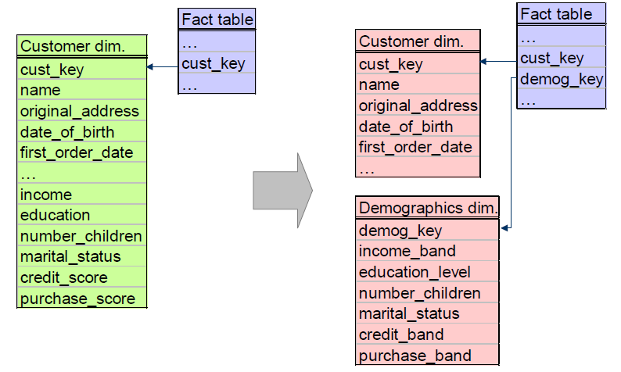
Demographic Mini-dimension

Slide 16
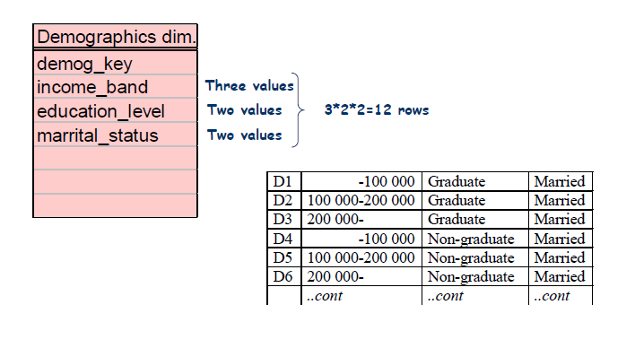
Demographic Mini-dimension

Slide 17
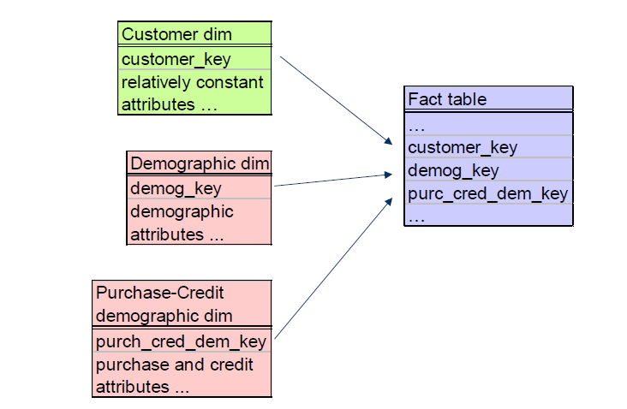
Two Demographic Mini-dimensions

Slide 18
Demographic Mini-dimension
• Advantages
– frequent ‘snapshoting’ of customers profiles with no increase in data storage or data complexity
• Drawbacks
– the demographic attributes are clumped into banded ranges of discrete values (it is impractical to change the set of value bands at a later time)
– the demographic dimension itself can not be allowed to grow too large
– slows down the browsing
• What if the fact table (connecting the demographic mini-dimension with the customer dimension) is sparse?

Slide 19
Demographic Mini-dimension
• What to do if the fact table (connecting the
demographic mini-dimension with the customer
dimension) is sparse?
– Define a demographic transaction event, i.e., introduce a new fact table
or
– Add a current demographic key to the customer dimension table

Slide 20
Outrigger Dimensions
Look like a beginning of a snowflake
Example:
Large number of attributes
Different grain
Different update frequency
Customer dimension
Customer key PK
Fname
Lname
Address
County
County demographics
…
Fact table
Customer key FK
….
County demographics
Outrigger dimension
County Demogr key
Total population
Males
Female
Under 18
…

Slide 21
Junk Dimensions
When a number of miscellaneous flags and text attributes exist, the following design alternatives should be avoided:
• Leaving the flags and attributes unchanged in the fact table record
• Making each flag and attribute into its own separate
dimension
• Stripping out all of these flags and attributes from the design
A better alternative is to create a junk dimension.
A junk dimension is a convenient grouping of flags and
attributes to get them out of a fact table into a useful
dimensional framework

Slide 22
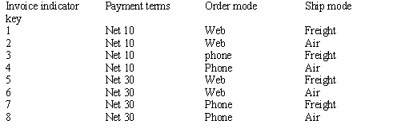
“Junk” Dimensions
Miscellaneous flags and text attributes that cannot be placed into one of existing dimension tables
Store them in a “junk” dimension
Store as unique combinations
Example:
Data profiling is useful in identifying junk dimension candidates

Slide 23
Dimension Role Playing
A single table that plays multiple roles (using views) to create synonym dimension attributes.
Most common role playing dimension is the Date Dimension. i.e. separate role playing dimensions for order date and ship date.

Slide 24
Role-Playing Dimension
What to do when a single dimension appears several times in the same fact table?
Consider a fact table to record the status and final disposition of a customer order
Dimensions of this table could be Order Date, Packaging Date, Shipping Date, Delivery Date, Payment Date, Return Date, Refer to Collection Date, Order Status, Customer, Product, Warehouse, and Promotion.

Slide 25
Role-Playing Dimension
Note that the first 7 dimensions are all time
7 FKs from the FT to the time dimension!!
We can not join these 7 FKs to the same table
SQL would interpret such a seven-way simultaneous join as requiring that all of the dates be the same
Is this what we want?

Slide 26
Role-Playing Dimension
We need to make SQL believe that there are 7 independent time dimension tables
The column labels in each of these tables should also be different!
WHY?
We will not be able to tell the columns apart if several of them have been dragged into a report
How can we do this?

Slide 27
Role-Playing Dimension
We cannot literally use a single time table
But we still want to build & maintain single time table behind the scenes
Create an illusion for the user
Make 7 identical physical copies of the time table
Make 7 “virtual” copies using the SQL’s SYNONYM command
Once these clones are in place, we still need to define a SQL view on each copy in order to make the field names uniquely different.

Slide 28
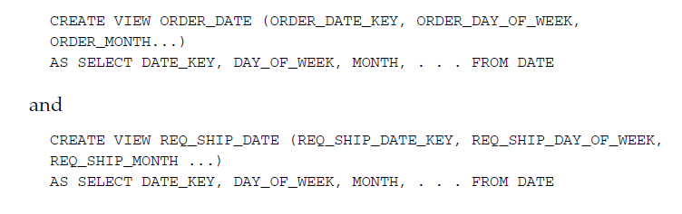
Use of ‘View’ as ‘Role playing Dimension’

Slide 29
Role-Playing Dimension
Now that we have seven differently described Time dimensions, they can be used as if they were independent
Can have completely unrelated constraints, and they can play different roles in a report

Slide 30
Role-Playing Dimension
Other Example
Frequent Flyer flight segment FT need to include Flight Date, Segment Origin Airport, Segment Destination Airport, Trip Origin Airport, Trip Destination Airport, Flight, Fare Class, and Customer.
The 4 Airport dimensions are 4 different roles played by a single underlying Airport table

Slide 31
Date/Time Dimensions
Standard date dimension table at a daily grain
Rationale: remove association with calendar from BI applications
Use numeric surrogate keys for date dimension tables
Date Dimension
Date key pk
Calendar Date
Calendar Month
Calendar Day
Calendar Quarter
Calendar Half year
Calendar Year
Fiscal Quarter
Fiscal Year
…

Slide 32
Date/Time Dimensions
Time of day should be treated as dimension only if there are meaningful textual descriptions for periods within the day
Example; lunch hour, rush hours, etc.
Otherwise, time of day needs to be represented as a simple non-additive fact or a date/timestamp

Slide 33
Date/Timestamp
Used in the fact table to support precise time interval calculated across fact rows
Calculations to be performed by ETL system
Example: elapsed time between original claim date and first payment date

Slide 34
Multiple Time Zones
Express time in coordinated universal time (UTC)
Additionally, may be expressed in local time
Other options: use a single time zone (for example, ET) to express all times in this zone
local call date
dimension
Call Center Activity Fact
Local call date key FK
UTC call date key FK
Local call time of day fk
UTC call time of day fk
…
Local call time of
day dimension
UTC call date
dimension
UTC call time of
day dimension

Slide 35
Degenerate Dimensions
Occur in transaction fact tables that have a natural parent-child structure
Key remains the only attribute left after other attributes got separated into dimensions
Key should be the actual transaction number
Stored in a fact table - do not create a corresponding dimension table

Slide 36
Heterogeneous Products
Some products have many, many distinguishing attributes
and many possible permutations (usually on the basis of
some customised offer). This results in immense
product dimensions and bad browsing performance
• In order to deal with this, fact tables with
accompanying product dimensions can be created for
each product type - these are known as custom fact
tables
• Primary core facts on the products types are kept in a
core fact table (but can also be copied to the
conformed fact tables)

Slide 37
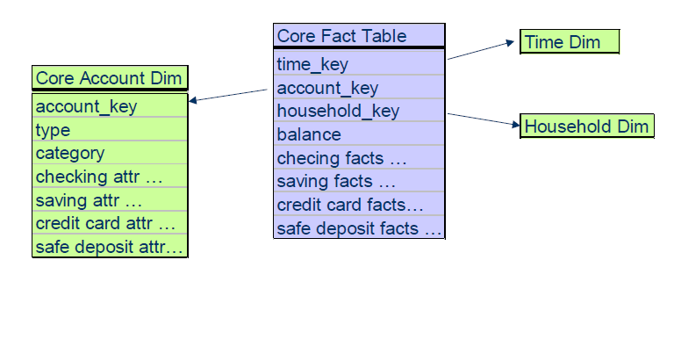
Heterogeneous Products

Slide 38
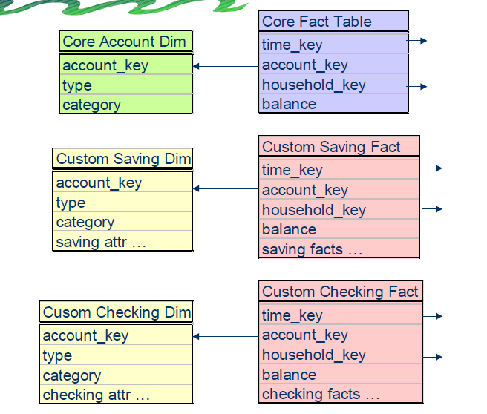
Heterogeneous Products

